Slide 1
The Influence of Emotion on Keystroke Patterns in Android platform: An Experimental Study Using Auditory Stimuli
Proposed by:-
Lillita Rhea D’souza
Chaitrali Gandhi
Naman Malik

Slide 2
1.
Keystroke Dynamics

Slide 3
Types of User Authentication
User Authentication
Knowledge Based
Object Based
Biometrics Based
Physiological
Behavioural
Fingerprints, Face Recognition, Iris, Retina, Hand Geometry
Keystroke Dynamics, Voice, Gait, Lip Movement, Signature

Slide 4




Physiological Based Authentication
Fingerprints
Face Recognition
Iris and Retina Scanning
Hand Recognition

Slide 5
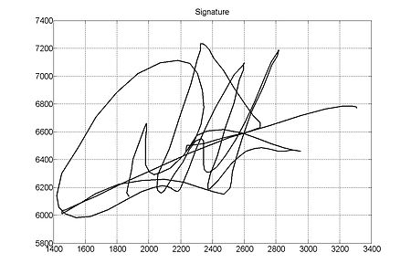

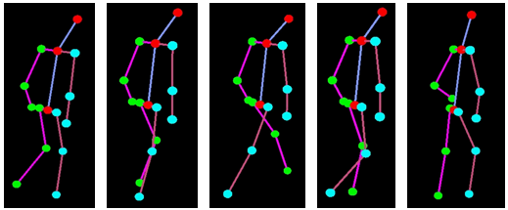
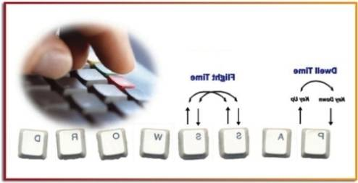
Behavioural Based Authentication
Signature Recognition
Voice Pattern
Gait (way of walking)
Keystroke Dynamics

Slide 6

What is Keystroke Dynamics?
Keystroke dynamics or typing dynamics refers to the automated method of identifying or confirming the identity of an individual based on the manner and the rhythm of typing on a keyboard.

Slide 7
2.
Literature Survey

Slide 8
Keystroke dynamics on Android Platform
-Margit Antal
Implemented on smart phone
Two additional features of pressure and finger area was used
Android Application was made
User was authenticated based on keystroke duration and pressure using Manhattan classification, Euclidean and compared

Slide 9
Dynamic User Verification Using Touch Keystroke Based on Medians Vector.
Proximity -Shatha J. Alghamdi and Lamiaa A. Elrefaei
Implemented on smartphone
Two additional features of pressure and finger area was used
Android Application was made
User was authenticated based on Median Vector Proximity algorithm
This was implemented on 17 subjects, 16 were attackers and 1 was genuine and the error rate was less as compared to the previous one.

Slide 10
The Observation
Both the papers mentioned the disadvantage/Hypothesis that:-
EMOTIONS PLAY A ROLE IN KEY ROLE IN KEYSTROKE DYNAMICS

Slide 11
Identifying emotion by keystroke dynamics and text pattern analysis
- A.F.M. Nazmul Haque Nahin, Jawad Mohammad Alam, Hasan Mahmud, and Kamrul Hasan
Used Keystroke and text pattern analysis
Asked the user multiple times to enter mood and free text
Estimated mood via the keystroke duration and text pattern analysis and compared with actual results.

Slide 12
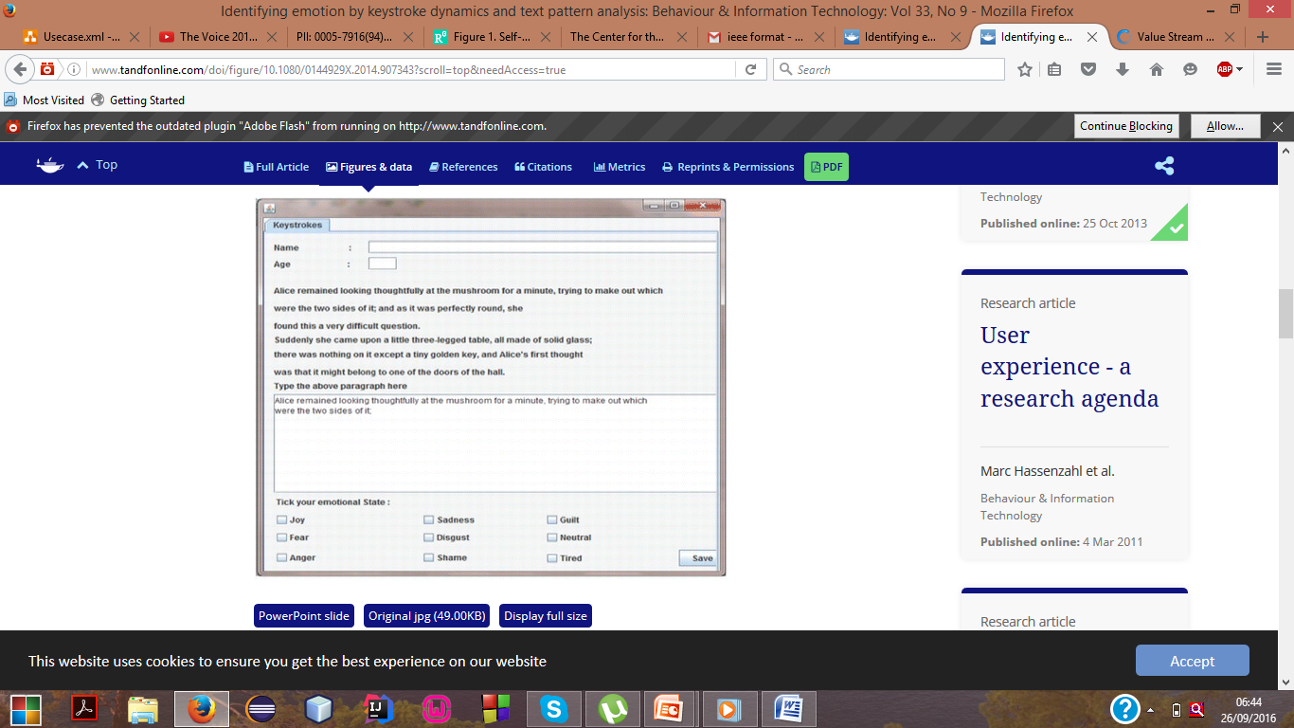
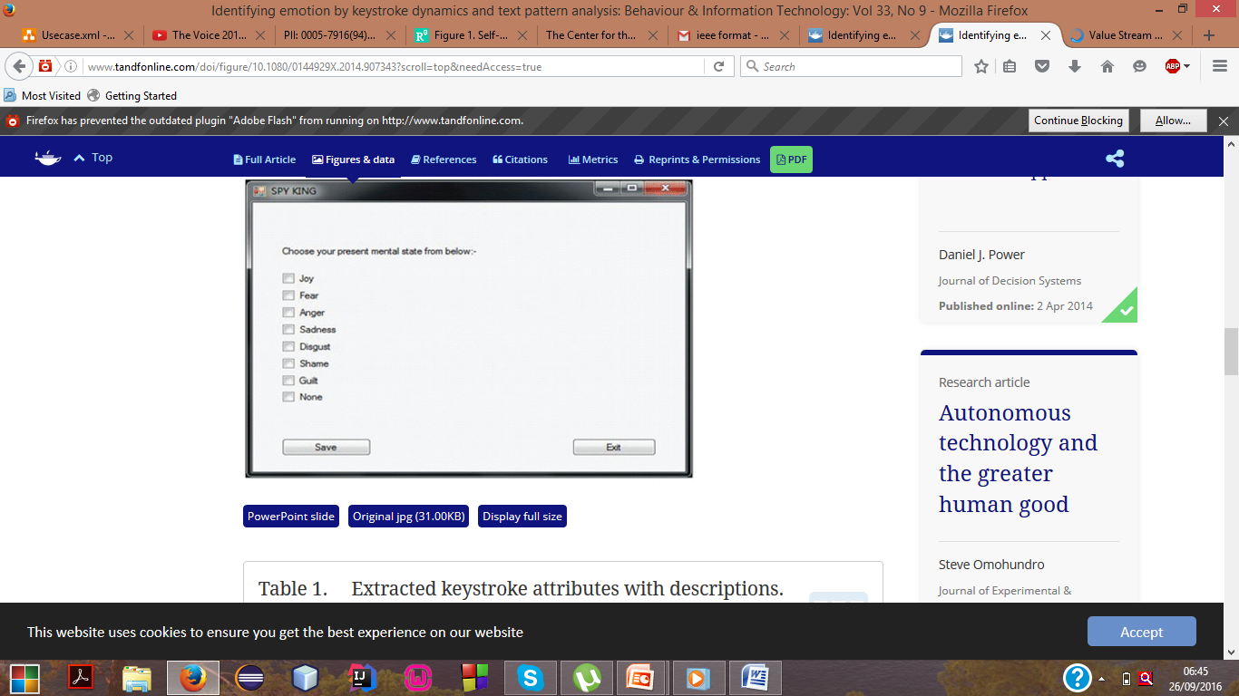

Slide 13
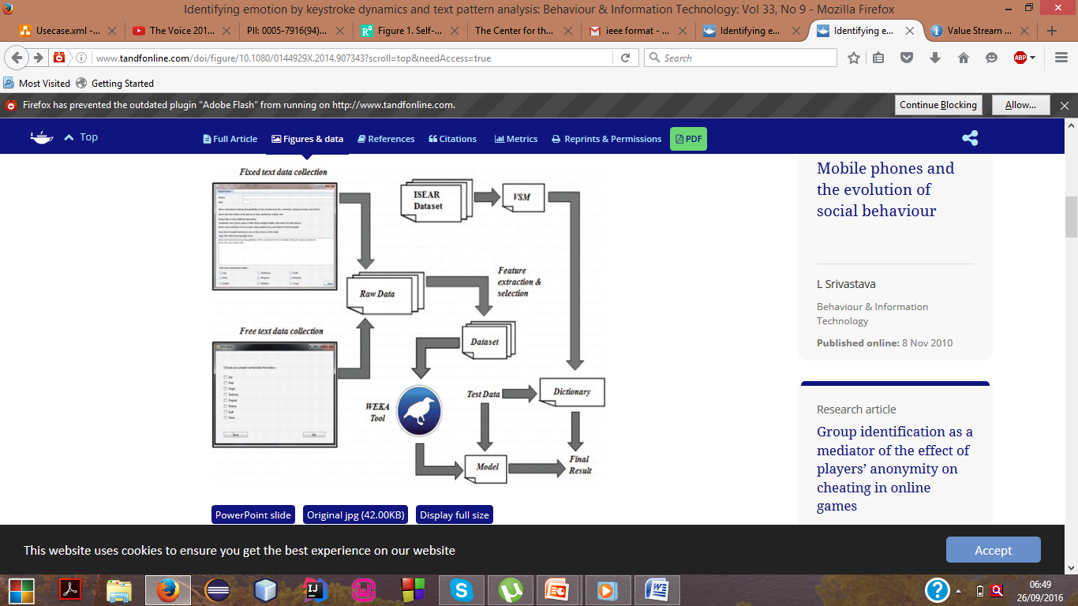

Slide 14
The Influence of Emotion on Keyboard Typing: An Experimental Study Using Auditory Stimuli - Po-Ming Lee, Wei-Hsuan Tsui, Tzu-Chien Hsiao
Emotions were changed based on IADS (International Affective Digitized Sounds- Centre of Emotion and Attention (Florida))
Subject had to enter a fixed text for different sounds and variance was calculated
Done on PC

Slide 15
3.
Our Proposal

Slide 16
Data Collection Process
Subject: Use 52 subjects
Procedure: Instructed to type-in a target typing text "748596132" for 63 trials.
Use Self-Assessment Manikin (SAM), an affective rating system to calculate arousal and valence

Slide 17
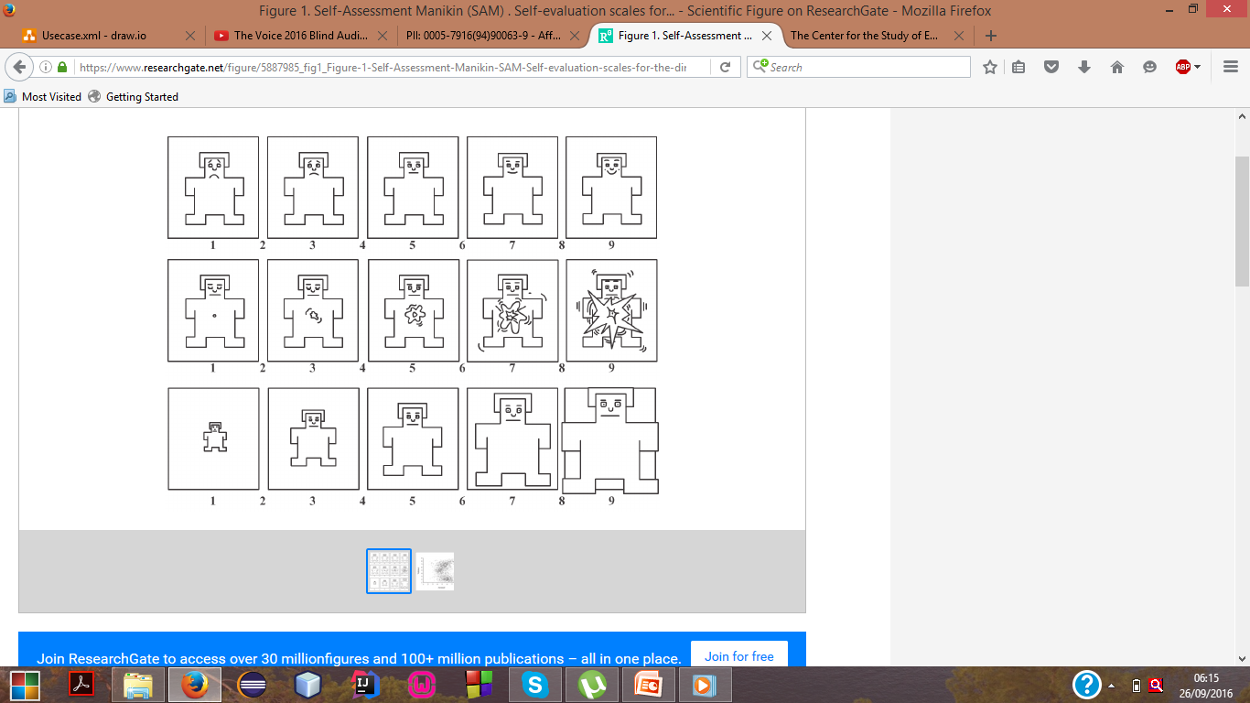
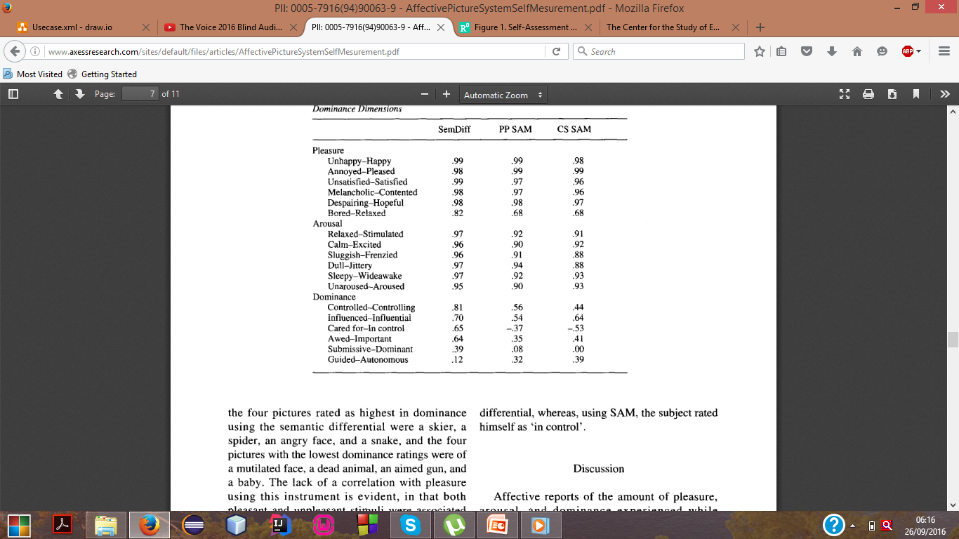

Slide 18
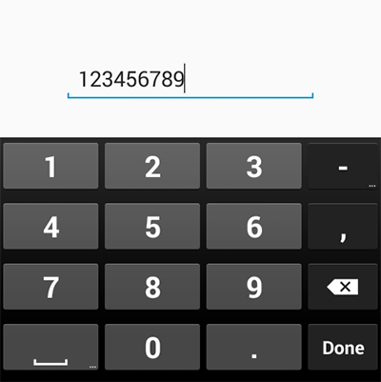
748596132
Why This number?

Slide 19
4.
Our Progress

Slide 20
The Progress of the Project
      Android Tutorial has been completed
Understanding ANOVA
Applied for SAM
Applied for IADS
Began work on UI

Slide 21
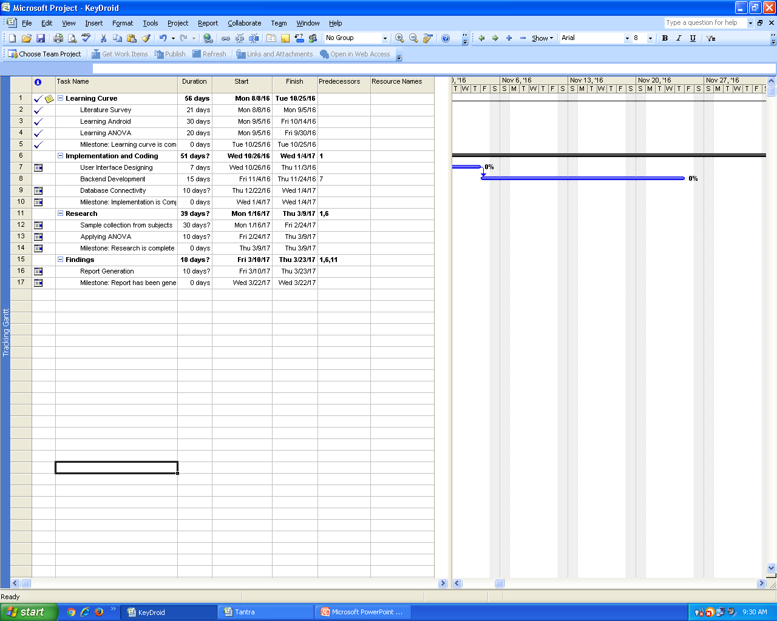
Task List

Slide 22
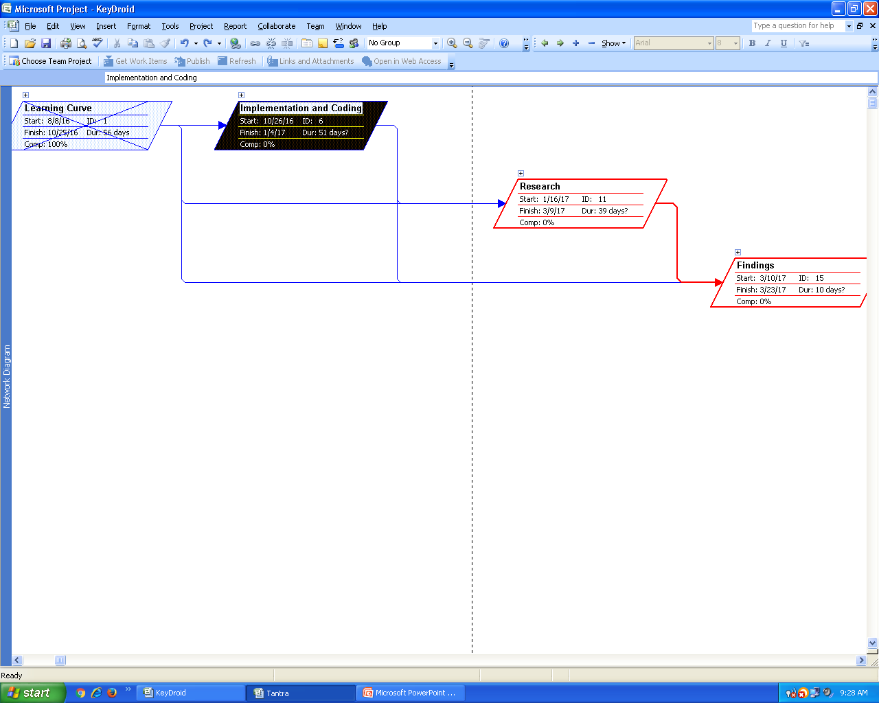
Network Diagram

Slide 23
5.
Project Design

Slide 24
Input Device (Keyboard)
Flowchart
Extract the keystroke duration and latency from the correctly typed data
Display the text to be typed
Subject is made to listen to the sound to change the emotion
Data is submitted to the valence and arousal with the accuracy data
Subject types the text
Display the keystroke latency and duration as the result
Pre-processing unit

Slide 25
Block Diagram

Slide 26
Use Case Diagram

Slide 27
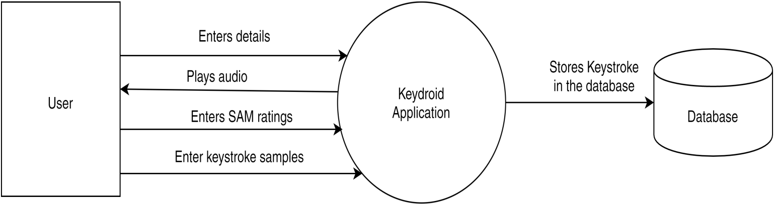
Data Flow Diagram

Slide 28
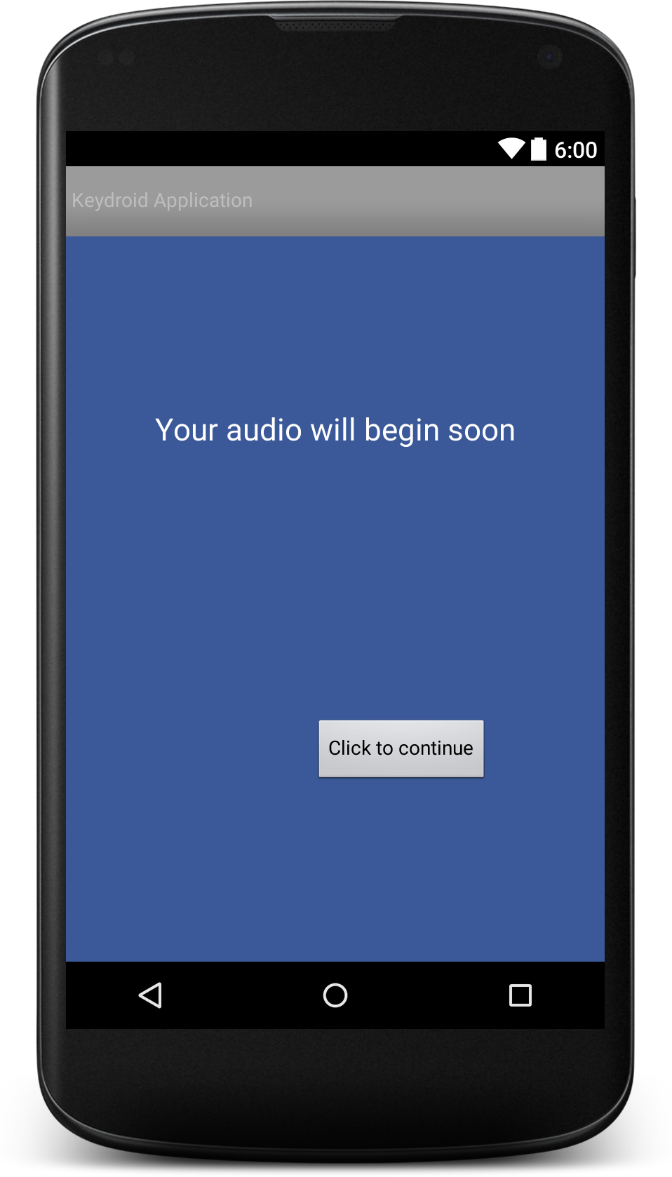
Android User Interface Design
Place your screenshot here

Slide 29
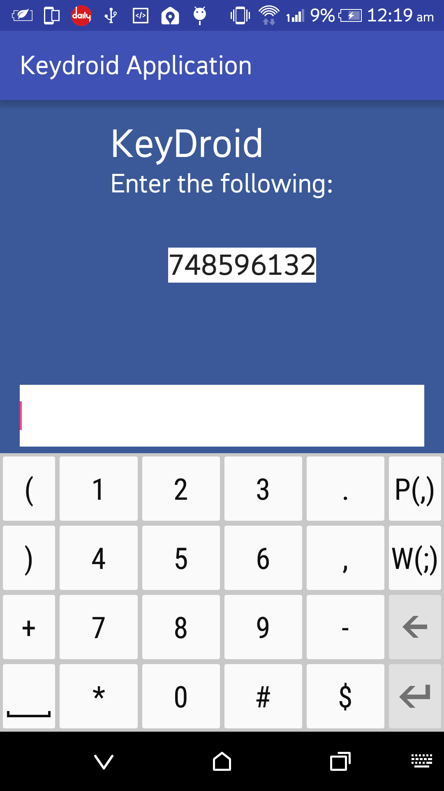
Android User Interface Design
Place your screenshot here

Slide 30
References
[1] Margit ANTAL, LászlóZsolt SZABÓ, Izabella LASZLO, “Keystroke Dynamics on Android Platform”, October 2014
[2] Shivshankar Rajput, Priyanka Vijayawargiya, "Implementation of Keystroke Dynamics Application for Identifying Emotional State", May 2015
[3] Shatha J. Alghamdi ,Lamiaa A. Elrefaei, “Dynamic User Verification Using Touch Keystroke Based on Medians Vector Proximity”, Computational Intelligence, Communication Systems and Networks (CICSyN), 2015 7th International Conference, June 2015
[4] Po-Ming Lee, Tzu-Chien Hsiao"The effect of emotion on keystroke: An experimental study using facial feedback hypothesis" ,Plos One, June 2015
[5] Po-Ming Lee, Wei-HsuanTsui, Tzu-Chien Hsiao, “The Influence of Emotion on Keyboard Typing: An Experimental Study Using Auditory Stimuli”, Plos One, June 2015

Slide 31
Thank You !

